Slide 1

Airplane crashes analysis from 1920 to 2023 prepared by : Mohamed araby batch: MIP – DA - 06

Slide 2

AGENDA
Introduction
Objective
Data Cleaning
Importing Data
Visualizations
Summary

Slide 3

introduction
Airline travel has become increasingly safe over the decades, but crashes still occur. To understand how safety has evolved and identify areas for further improvement, this analysis will explore airplane crash data from 1920 to 2023.

Slide 4

objective
This analysis aims to uncover the underlying factors contributing to airplane crashes over an extensive period (1920-2023). By identifying trends and patterns, the objective is to improve aviation safety through targeted preventative measures.

Slide 5
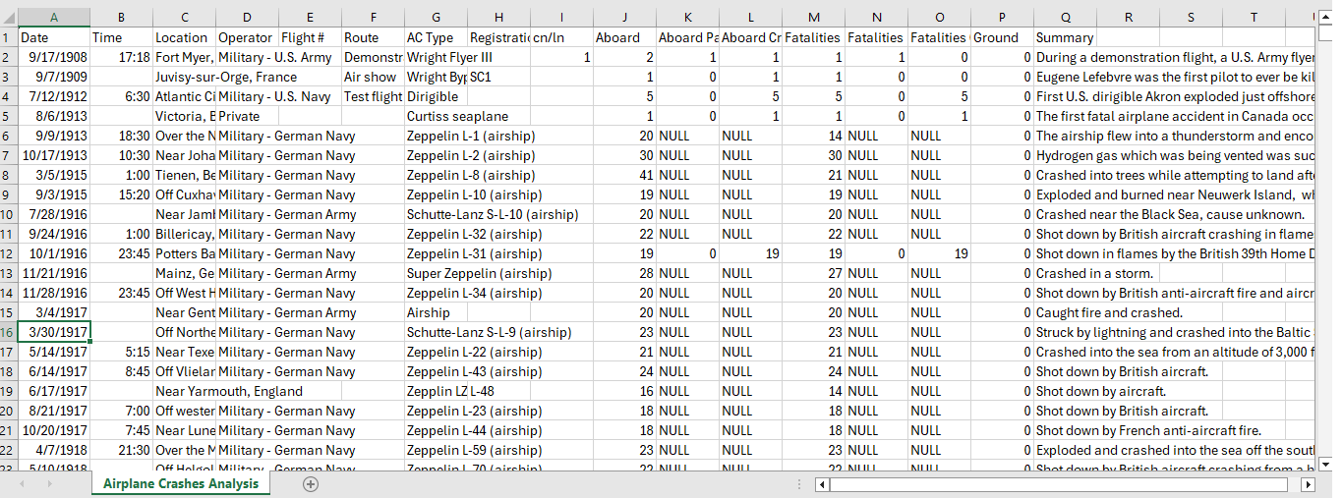
Data cleaning
This is the first sight on the data

Slide 6
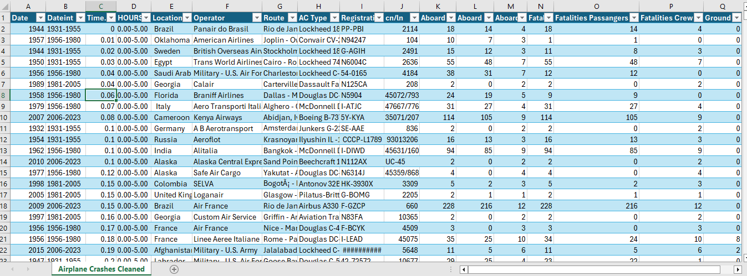
Data cleaning
Data after dealing with nulls and blanks and making it easier to deal with

Slide 7
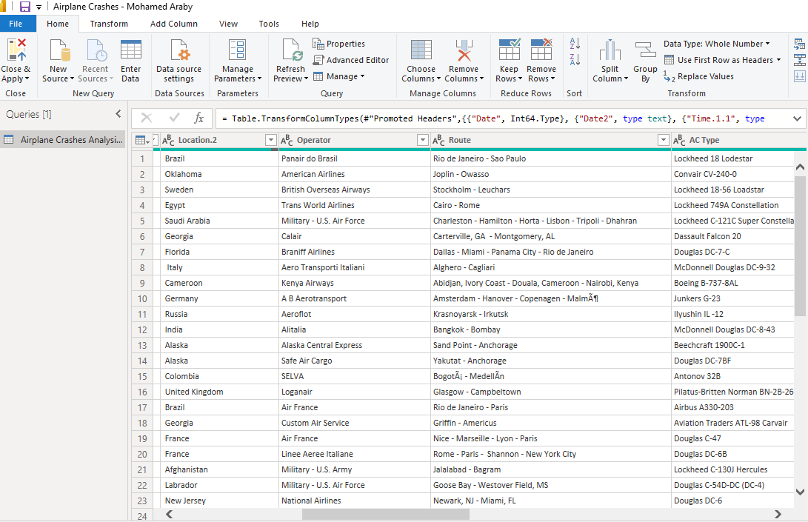
Importing data
Importing dataset and detecting data type using power query editor

Slide 8

The analysis will focus on airplane crashes that occurred between 1920 and 2023, providing a comprehensive understanding of crash patterns over a century. This extended timeframe allows us to identify how safety measures and technology advancements have influenced crash trends. Geospatial analysis investigations explore crash locations to identify potential regional risks or pinpoint areas for improved safety infrastructure.
Temporal and Geospatial Analysis

Slide 9
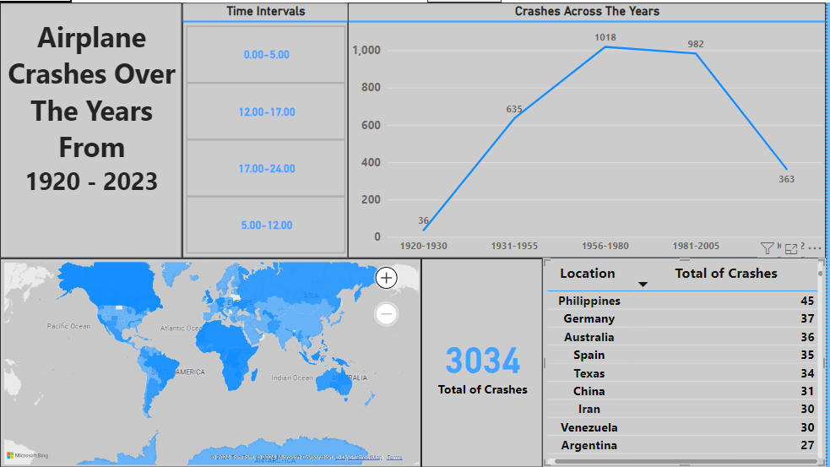
Temporal and Geospatial Analysis

Slide 10
This section will focus on the airlines or organizations operating the aircraft involved in crashes.
It will analyze the safety record of different operators and identify any trends related to operator performance.
It's important to note that operator performance should be analyzed considering factors beyond raw crash data. This might involve including information on the number of flights operated by each company for a fairer comparison.
Operator Performance And Aircraft Involvement

Slide 11
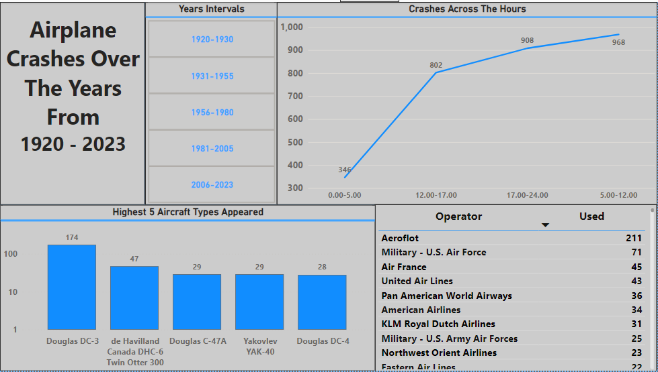
Operator Performance And Aircraft Involvement

Slide 12
This section focuses on the analysis of fatality trends and patterns within airplane crashes occurring between 1920 and 2023. The primary objective is to identify any significant changes in the overall number of fatalities over this period. Additionally, we will explore potential contributing factors associated with these fatalities
Fatality Trends And Patterns

Slide 13
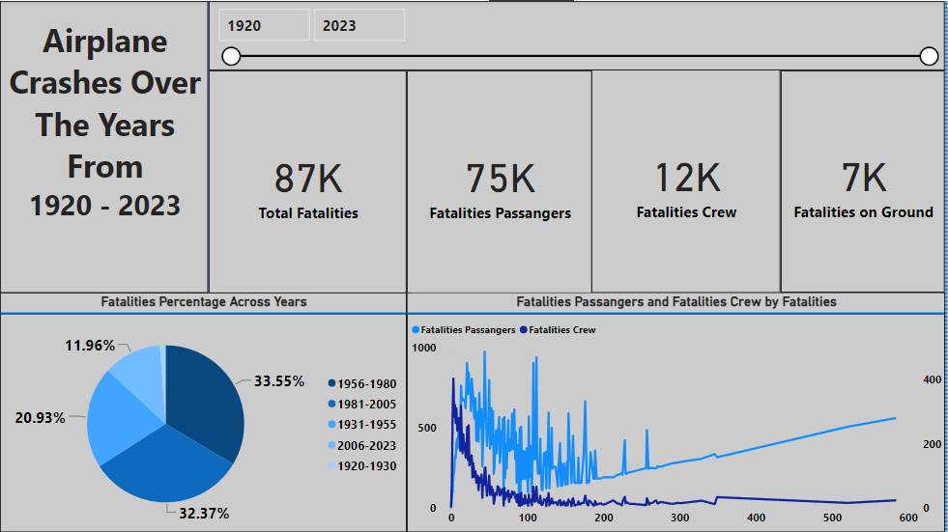
Fatality Trends and Patterns

Slide 14

Summary
Airplane crashes from 1920-2023 are analyzed to uncover trends and contributing factors. This data will be used to guide future safety improvements.

Slide 15

THANK YOU

